Slide 1
Cover Ratio Maximization
Keming Li 2020/4/17

Slide 2
This week
OS report4 7~15
优秀毕业生资料整理上交， 优秀毕业生采访
Compare prun CellTree ref to k in kSPR
CGAl
Summary of current works(not finished)

Slide 3
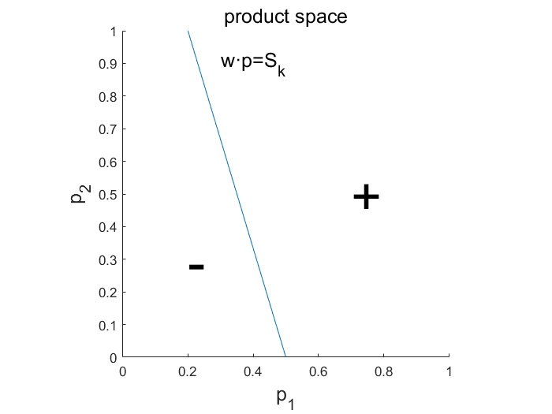
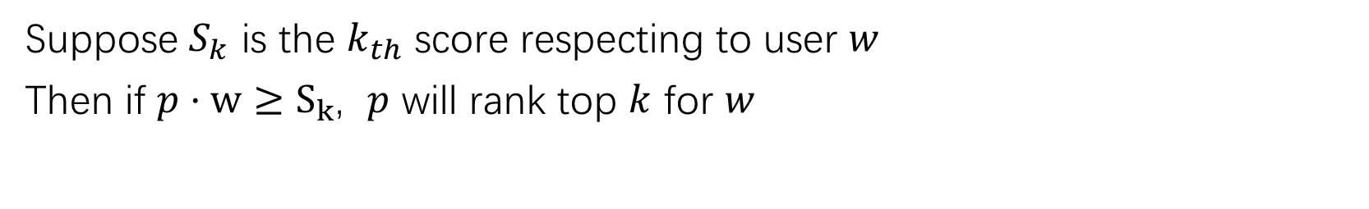

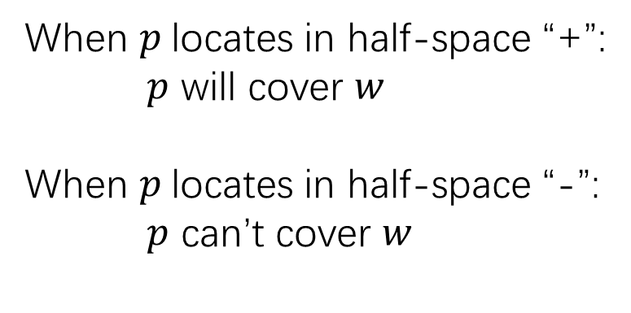
How a new product $p$ cover the user $w$
Suppose $S_{k}$ is the $k_{th}$ score respecting to user $w$
Then if $p·w≥S_{k}$, $p$ will rank top $k$ for $w$
When $p$locates in half-space “+”:
$p$ will cover $w$
When $p$locates in half-space “-”:
$p$ can’t cover $w$

Slide 4
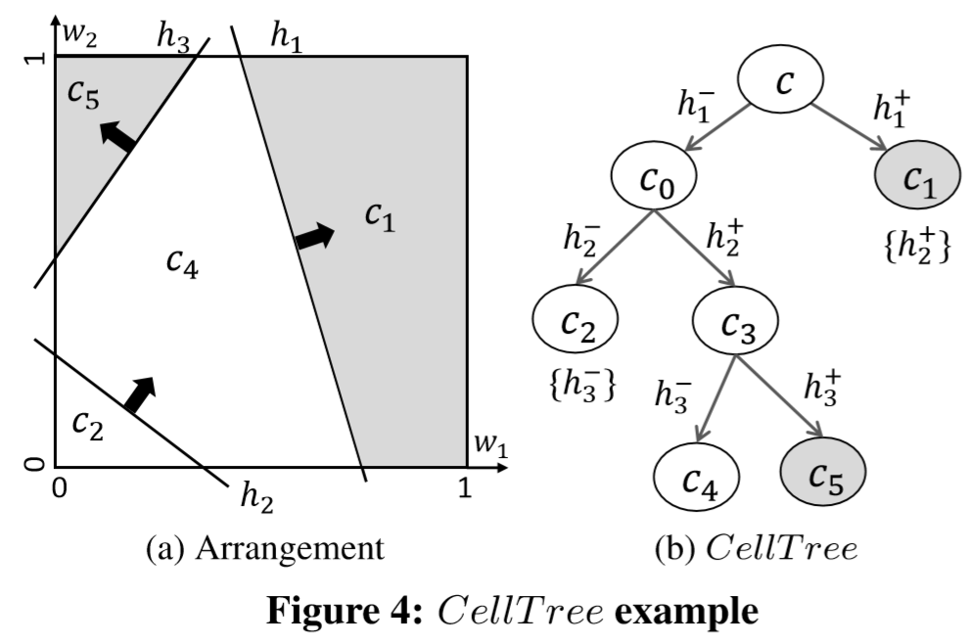
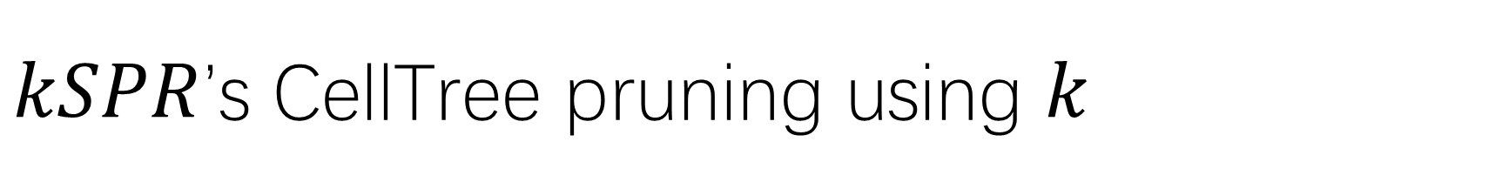
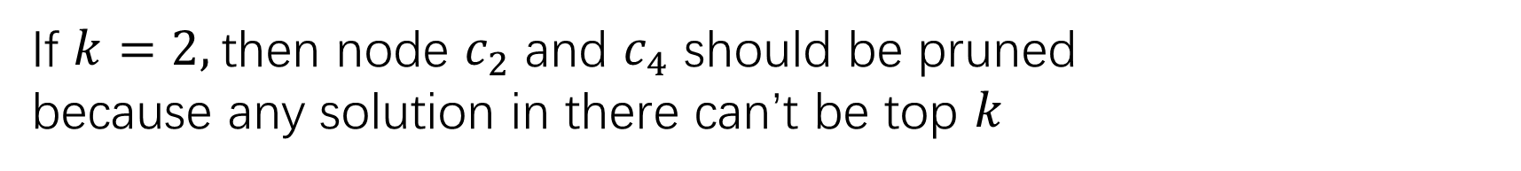
$kSPR$’s CellTree pruning using $k$
If $k=2,$then node $c_{2}$ and $c_{4}$ should be pruned
because any solution in there can’t be top $k$

Slide 5
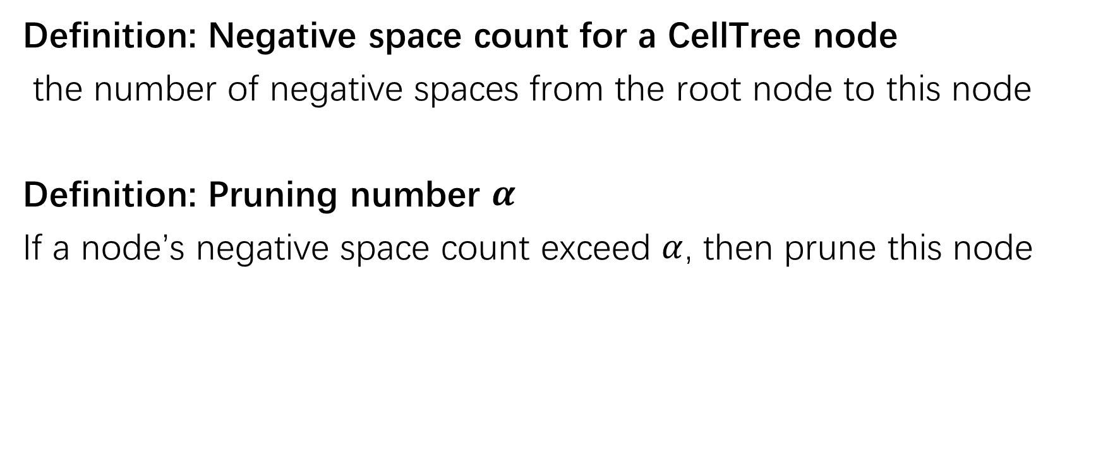
Pruning number
Definition: Negative space count for a CellTree node
the number of negative spaces from the root node to this node
Definition: Pruning number $α$
If a node’s negative space count exceed $α$, then prune this node

Slide 6
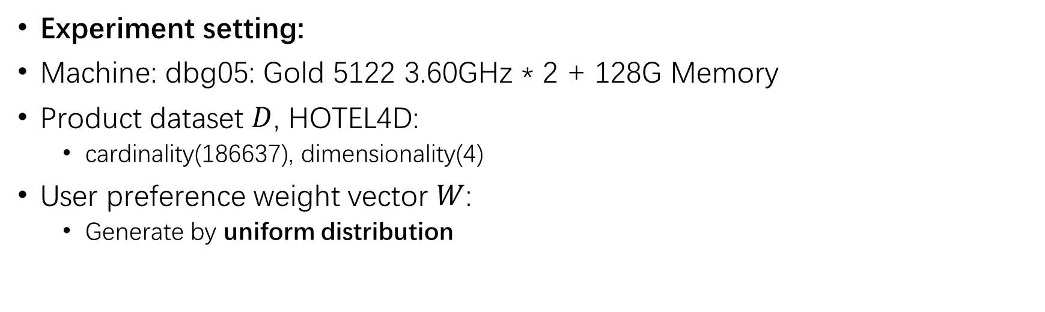

The effect Pruning number $α$
Experiment setting:
Machine: dbg05: Gold 5122 3.60GHz * 2 + 128G Memory
Product dataset $D$, HOTEL4D:
cardinality(186637), dimensionality(4)
User preference weight vector $W$:
Generate by uniform distribution

Slide 7
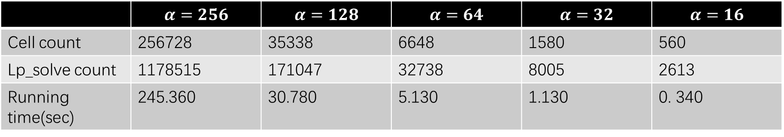

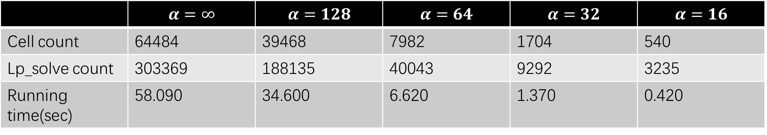

The effect Pruning number $α$
Card($W$)=1k
 | $$α=∞$$ | $$α=128$$ | $$α=64$$ | $$α=32$$ | $$α=16$$
Cell count | 64484 | 39468 | 7982 | 1704 | 540
Lp_solve count | 303369 | 188135 | 40043 | 9292 | 3235
Running time(sec) | 58.090 | 34.600 | 6.620 | 1.370 | 0.420
Card($W$)=10k
 | $$α=256$$ | $$α=128$$ | $$α=64$$ | $$α=32$$ | $$α=16$$
Cell count | 256728 | 35338 | 6648 | 1580 | 560
Lp_solve count | 1178515 | 171047 | 32738 | 8005 | 2613
Running time(sec) | 245.360 | 30.780 | 5.130 | 1.130 | 0. 340

Slide 8
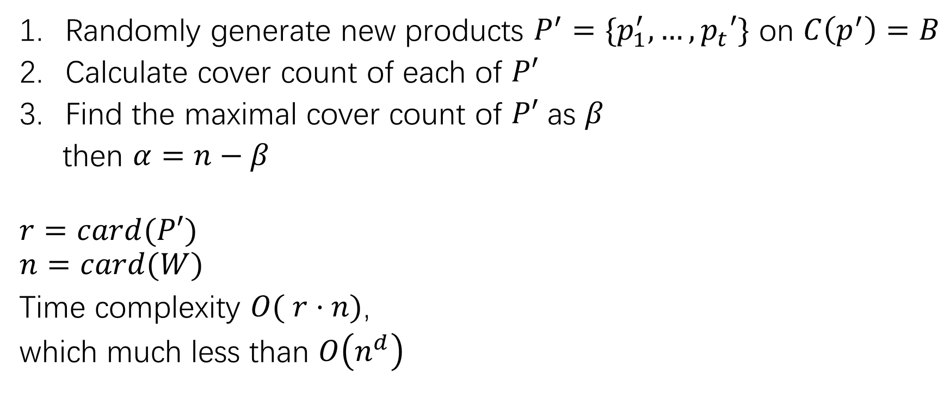
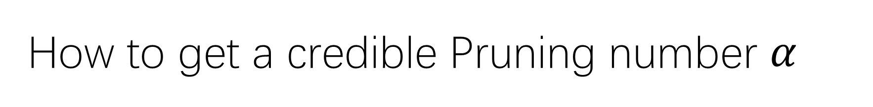
How to get a credible Pruning number $α$
Randomly generate new products $P^{′}=\{p_{1}^{′}, …,p_{t}′\}$ on $C\left(p^{′}\right)=B$
Calculate cover count of each of $P′$
Find the maximal cover count of $P′$ as $β$
then $α=n−β$
$$r=card(P′)$$
$$n=card(W)$$
Time complexity $O( r·n)$,
which much less than $O\left(n^{d}\right)$

Slide 9
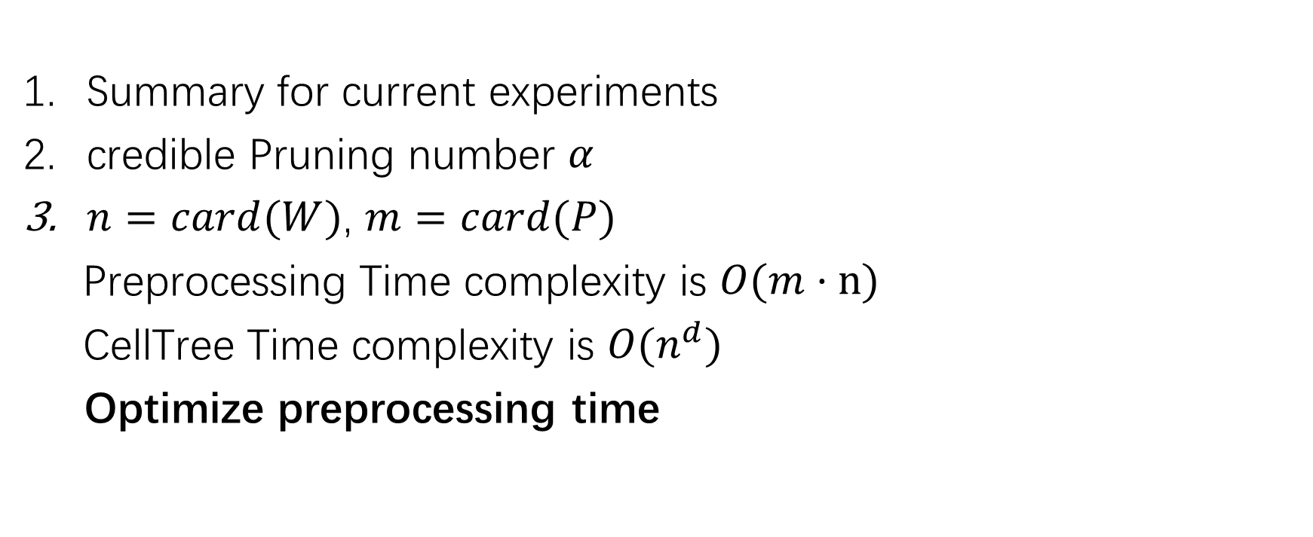
TODO
Summary for current experiments
credible Pruning number $α$
$n=card(W)$, $m=card(P)$
Preprocessing Time complexity is $O(m·n)$
CellTree Time complexity is $O(n^{d})$
Optimize preprocessing time

